Slide 1



Improving the value chain of unsold perishable food in supermarkets

Slide 2


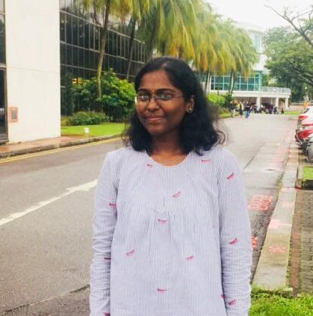

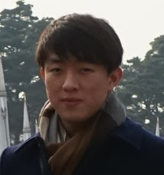




Who we are
A Group of Passionate Individuals
Judy Ong
Matthew Wong
Akshaya
Anto Lawrence
Digital Marketing
Graphic Designer
Developer
Aviva Guru
Collaborating partners:
Ferdi Lau
Jovi
Wei Chuen Kum
Financial Analyst
Data Analyst
Business Development

Slide 3
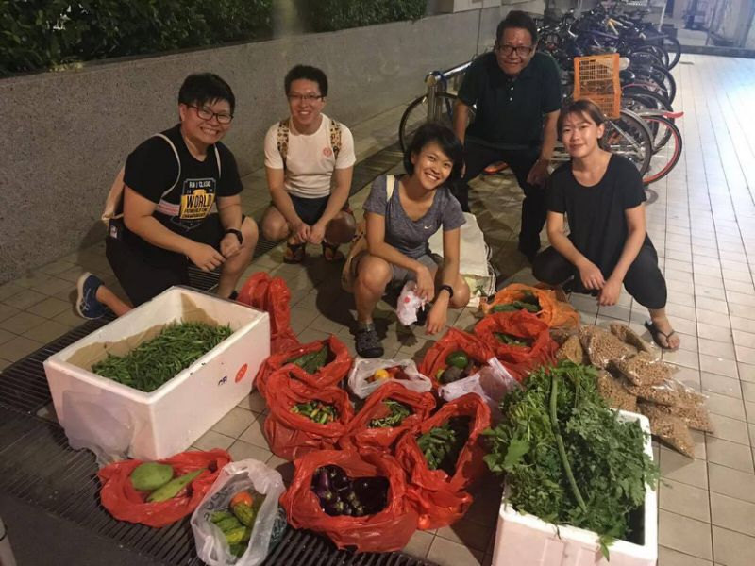

‘Freeganism’
Inspiration for our idea
Rising Trend of Millennials found digging through dumpsters
Source: Yahoo
Notes:
WHAT IS THE CUSTOMER PROBLEM?

Slide 4

Food Waste in Singapore
Quantifying the Severity of the Problem
2,160
Tonnes of food waste are generated in Singapore everyday (NEA, 2016)
...that’s equivalent to the weight of 432 school buses!
Notes:
As calculated by Jovi, Mathematician
1 ton = 2000 pounds
1 school bus = 10000 pounds
WHAT IS THE CUSTOMER PROBLEM?
Insert sources for the statistics (append to bibliography)
Stats for South East Asia to show the opportunity in Asia
In the world, 28% of the total food waste are from the Industrialized Asia (Japan, South Korea, and China), while the South and South East Asia waste 21%. The number showed that the level of wasted food in Asia is very high – nearly 50%.
While food waste is prevalent in the more developed economies of the region, it is a growing problem in the urban centres of many countries in Asia and the Pacific. On average, approximately 11kg of food per capita per year is wasted in developing Asian countries, while an estimated 80 kg of food per capita per year is waste in developed Asian countries (FAO, 2011).

Slide 5

Market Research
What did we find?
Only 14% of food waste is recycled
Perishables that do not pass cosmetic filtering test account for 60% of all food waste in Singapore (Fairprice, 2017)
Notes:
DEFINE COSMETIC FILTERING TEST WHEN PRESENTING

Slide 6

Food Waste in SE Asia
This problem affects SE Asia as well
11kg/capita per annum
80kg/capita per annum
Developing SE Asian countries
(i.e. Laos, Myanmar)
Developed SE Asian countries
(i.e. Singapore)
Source: Food and Agriculture Organisation, 2011)

Slide 7


Validation
What do Singaporeans think?
90% of Singaporeans are concerned about the issue (NEA, 2016)
95% feel the need to reduce food waste (Results from our survey with 113 respondents)
People want to get involved with reducing food waste!

Slide 8

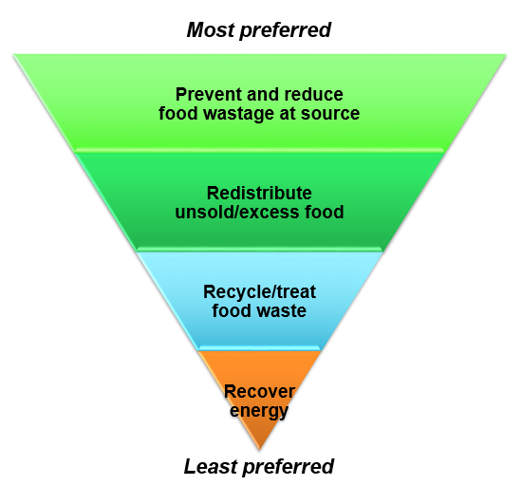






Current Solutions
Outreach Programmes
Education
Largely ineffective
Food sharing
Food bank
Donations
Onsite waste treatment
Composting
Biogas
Landfill
Incineration
Worst case scenario
Source: National Environmental Agency
Notes:
Thousands of people in the UK are increasingly reliant on food banks, the use of which has increased fourfold since 2012. Yet UK households threw away 7.3m tonnes of food in 2015, according to the environment, food and rural affairs committee.
Tesco uses an app, FoodCloud, developed by two Trinity College Dublin graduates, to itemise the surplus food in each store at the end of the day. This information is then shared with local charities that collect the food.

Slide 9
Improving the value chain of unsold perishable food in supermarkets

Slide 10

Customer Persona
“I care about our environment and I think we should increase food waste recycling!”
Name: Jenny
Age: 35
Occupation: Teacher
Additional info: Value-Seeker, Environmentally conscious, Frugal spender
Notes:
Millennial who wants to make a difference

Slide 11

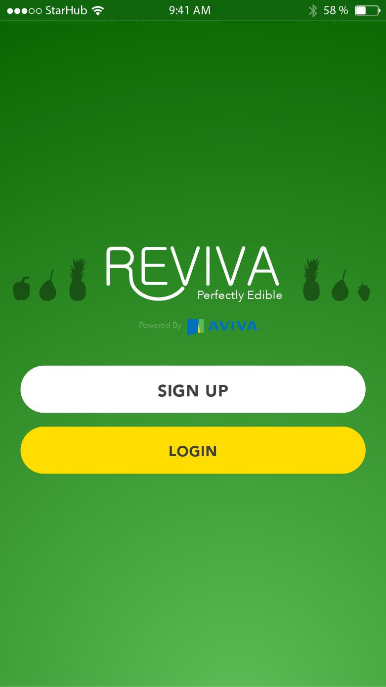
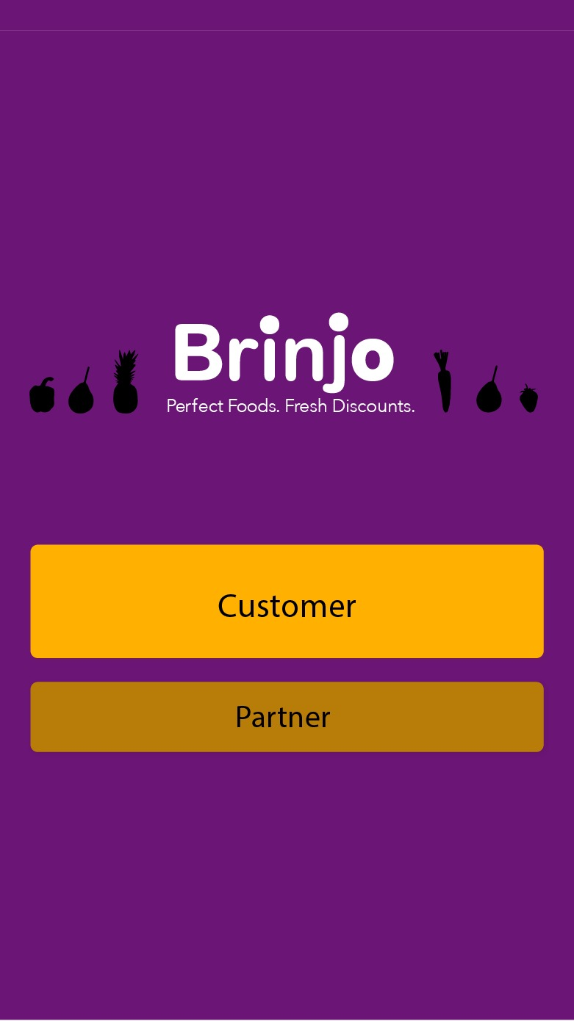
Our Solution
Inclusive Food Ecosystem
Integrated digital platform that connects supermarkets with unsold perishable food to value-seekers and/or the environmentally conscious
Goal: Reallocate perishable food efficiently to reduce overall food wastage in Singapore and ensure food sustainability (SDG #11)

Slide 12
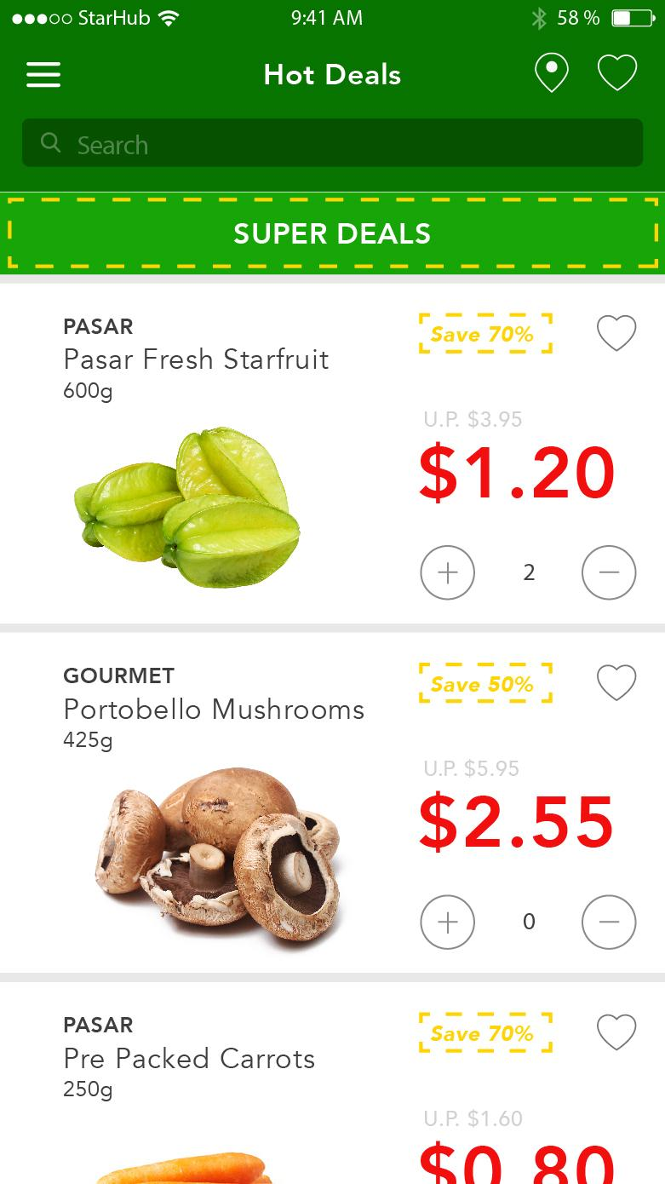
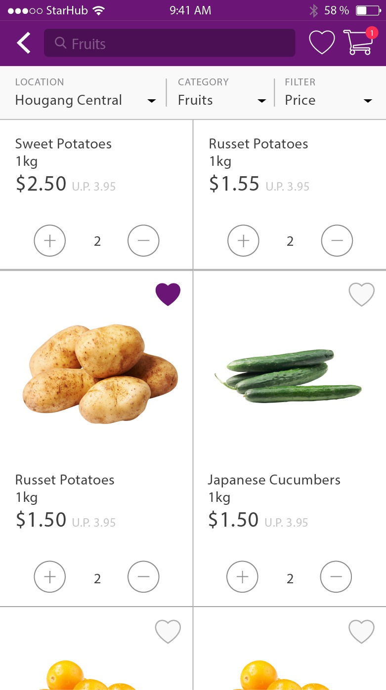
Our Solution
How it works
1. Food Matching
At the end of the day, unsold perishable food in supermarkets will be listed on our platform at discounted prices
Market Validation
✓ 60% are willing to purchase vegetables that do not pass the cosmetic filtering test
✓ 66% will make the purchase if the discount ranges between 30 - 50%
✓ 91% are willing to download and use this app
Notes:
WE GON SEE A DEMO

Slide 13




Our Solution
How it works
2. Redistribution of remaining food
Remaining food not sold by the end of the day will then be distributed to:
1. Soup Kitchens
2. Powder-processing companies
3. Compost facilities
Biomax Thermophilic Digester
Resulting in 100% of food waste from supermarkets recycled!

Slide 14





Improved Supply Chain
Horizontal and Vertical Integration
Customers
Soup Kitchens
Powder-Processing Companies
Supermarket
Compost
Vendors
Mobile App Platform
Redistribution
Notes:
1-1 to 1-4
Value to customer -> we scale through partnerships

Slide 15





Value Proposition
Pain reliever for supermarkets
The unsold perishable goods presents a significant loss in the daily revenue for supermarkets. The use of our platform will convert previously unwanted food to money for them
Gains creator for customers
Save money spent on groceries
Supermarket
Customer
In turn, this helps to reduce food waste & ensure food sustainability!

Slide 16


Competitor Analysis
Assessing the Impact-Effort Matrix
Modifying the Supply Chain
Education/Public Awareness
Impact
Sharing Economy
Food Donation
Effort

Slide 17
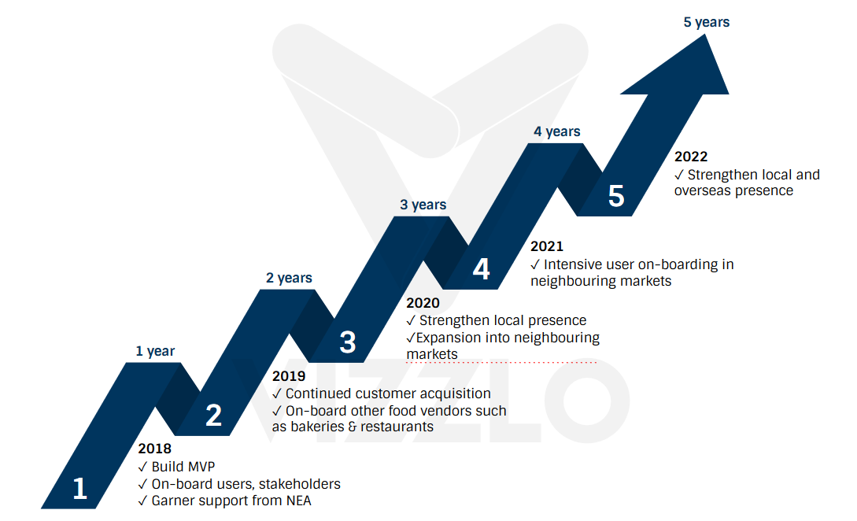
Proposed Roadmap
Go-to-market Strategy

Slide 18






Channels
How do we intend to reach our customer segments?
Digital Marketing
Campaigns
Storefront Publicity
Collaboration

Slide 19






Key metrics
How to determine our success?
Consumers
Vendors
Sustainability
50,000 App Downloads
100 Merchants Onboarded
80% of Food Waste Redistributed
17,000
Active Users
Conversion rate of merchants
Sustainable Food Waste Management
Notes:
Revenue
Merchant conversion rate: (# of items sold/ # of items listed)

Slide 20
Revenue Stream
How do we monetise?
Commission fees paid by supermarkets
Commission fees paid by customers
10% of cost of listed food items
5-7% of cost of food items purchased
Notes:
TIE IN W CUSTOMER SEGMENT - DO TMR

Slide 21

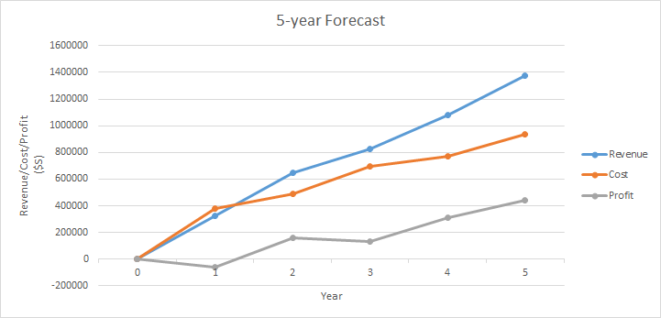
Projections
Our Quantifiable Impact and Financials
80%
Food Waste Reduction
40%
Revenue Growth
Notes:
Projections of revenue based on estimated reach
3 year, 5 year etc
Breakeven?

Slide 22




Integration with Aviva
Leveraging on Aviva’s Digital Edge
Reward System
Points accumulated through purchase converted to policy discounts
Customer Data
Used to formulate personalised plans and policies
Aviva’s Value
Preparing for uncertainty & protecting things important to customers in terms of: Financials, Environment and Community
Notes:
We have data on how people are eating -> insurance is lower for reviva members
REFINE TMR

Slide 23
Thank you!

Slide 24

Q&As

Slide 25
Exhibits
Exhibit 1: Survey Results
Exhibit 6: Proposed Solution
Exhibit 2: Cost Structure
Exhibit 7: Key Metrics
Exhibit 3: Projection
Exhibit 8: Channels
Exhibit 4: Supply Chain
Exhibit 9: Prototype
Exhibit 5: Roadmap
Exhibit 10: Revenue Stream

Slide 26
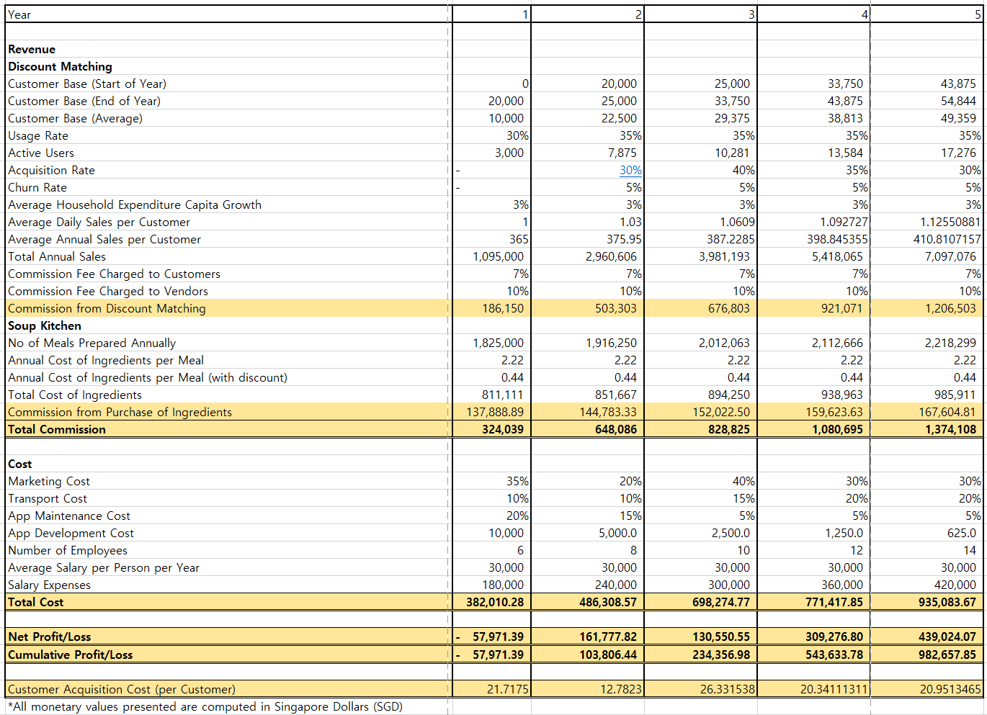
Exhibit 2: Cost Structure
Back

Slide 27
Exhibit 3: Projection
Back

Slide 28
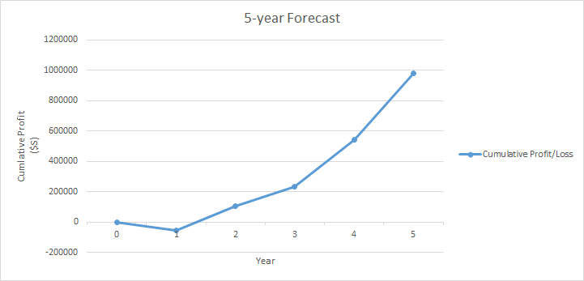
Exhibit 3: Projection
Back

Slide 29
Exhibit 4: Supply Chain
Back
Customers
Soup Kitchens
Powder-Processing Companies
Supermarket
Compost
Vendors
Mobile App Platform
Redistribution

Slide 30
Exhibit 5: Proposed Roadmap
Back

Slide 31
Exhibit 6: Solution
Back
1. Food Matching
At the end of the day, unsold perishable food in supermarkets will be listed on our platform at discounted prices
Market Validation
✓ 60% are willing to purchase vegetables that do not pass the cosmetic filtering test
✓ 66% will make the purchase if the discount ranges between 30 - 50%
✓ 91% are willing to download and use this app

Slide 32
Exhibit 6: Solution
Back
2. Redistribution of remaining food
Remaining food not sold by the end of the day will then be distributed to:
1. Soup Kitchens
2. Powder-processing companies
3. Compost facilities
Biomax Thermophilic Digester
Resulting in 100% of food waste from supermarkets recycled!

Slide 33
Exhibit 7: Key Metrics
Back
Consumers
Vendors
Sustainability
50,000 App Downloads
100 Merchants Onboarded
80% of Food Waste Redistributed
17,000
Active Users
Conversion rate of merchants
Sustainable Food Waste Management

Slide 34
Exhibit 8: Channels
Back
Digital Marketing
Campaigns
Storefront Publicity
Collaboration

Slide 35
Exhibit 9: Prototype
Back
Step 1:
Choose if you are a Customer / Partner
Step 2:
Customers get alerts when discounts are available in their proximity

Slide 36
Exhibit 9: Prototype
Back
Step 3:
Catalogue that shows a complete list of perishable food available at the end of the day
Step 4:
Reserve & Pay for your order on the app, and collect in store!

Slide 37
Exhibit 10: Revenue
Back
Commission fees paid by supermarkets
Commission fees paid by customers
10% of cost of listed food items
5-7% of cost of food items purchased

Slide 38

Pointers
What is our understanding of the problem in the market?
What solutions are there in the market?
How is our solution better than what is on the market?
How did we validate that the market will be willing to adopt our solution/platform
Competitor Analysis

Slide 39
Our Solution
Virality
What will pull customers in? Ability to buy/sell unsold food, and to help the environment
How the idea will spread? Referrals, awareness campaigns, government cooperation
How to make sure to obtain scale? Achieve 100% food recycling from user to composting

Slide 40

Preliminary Findings
We conducted a survey of 105 respondents
88% are concerned about the hygiene and quality
60% will be willing to purchase vegetables that did not pass the cosmetic filtering test
66% will consider if the discount is between 30-50%
91% indicated they would download this app
People want to get involved with reducing food waste
Notes:
Insert sources for the statistics (append to bibliography)

Slide 41









Stakeholders
Key Partners
Supply-side
Demand-side
Redistribution
Students
Supermarkets
Soup Kitchens
Value
Seekers
Powder- Processing
Facility
Bakeries
Environmentally
Conscious
Other Food
Establishments
Composting
Facility

Slide 42
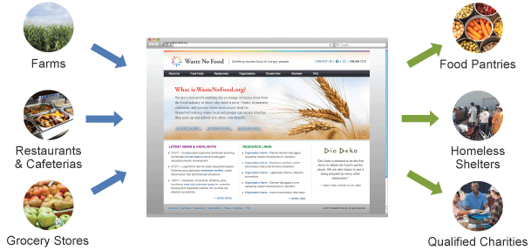
Competitive Advantage
What are the existing solutions
2016 French law bans grocery stores from throwing away edible food
Waste No Food, a nonprofit that has donated one million meals to California’s hungry and homeless population (May 2016)
Notes:
Government vs Non-profit vs Private firms

Slide 43
Proposed Roadmap
Go-to-market Strategy
Year 1 | Year 2 | Year 3 | Year 4 | Year 5
Build & Refine app Intensive onboarding of core customers: 20,000 app users Major Supermarket Chains Willing Hearts Composting facilities Powder-processing 10,000 tonnes of food redistributed | Customer Acquisition Onboarding of vendors: Bakeries Wet markets Hawker Centres Restaurants 20,000 tonnes of food redistributed | Expansion into neighbouring markets Strengthening local presence 30,000 tonnes of food redistributed | Intensive onboarding in neighbouring markets Strengthening local presence 40,000 tonnes of food redistributed | Strengthening overseas and local presence 50,000 tonnes of food redistributed
Notes:
REDO SLIDE
How we intend to expand to South East Asia - best to illustrate how the markets and behaviours are similar (high food wastage, youth engagement etc)
Establish strong ecosystem: demand matching and redistribution channels
1st year target: raw food wastage

Slide 44
Our App
The Customer Journey
Step 1:
Choose if you are a Customer / Partner
Step 2:
Customers get alerts when discounts are available in their proximity

Slide 45
Our App
The Customer Journey
Step 3:
Catalogue that shows a complete list of perishable food available at the end of the day
Step 4:
Reserve & Pay for your order on the app, and collect in store!

Slide 46

Proposed Roadmap
Go-to-market Strategy
✓ Build MVP
✓ Onboard users, supermarkets & distribution agents
✓ Garner support from NEA
✓ Continued customer acquisition
✓ Onboard other food vendors such as bakeries & restaurants
✓ Strengthen local presence
✓Expansion into neighbouring markets
✓ Intensive user onboarding in neighbouring markets
✓ Strengthen local and overseas presence
Year
2018
2019
2020
2021
2022

